Slide 1
“Big data”: challenges
and techniques
Nicola Romanò nicola.romano@ed.ac.uk
8 July 2019

Slide 2
Learning objectives
At the end of this session you should be able to:
Define “big data” in the context of biomedical research
Discuss the issues associated with big data
Describe a typical pipeline of genomic sequencing
Explain what dimensionality reduction techniques are and why are they used
Describe the idea (and some simple process) behind principal component analysis

Slide 3
What is big data?
What is “big data”?
“Big data is a simple way of referring to data sets whose size grows beyond the ability of software and hardware tools to manage, capture, and process in a reasonable timeframe. Big data is where the amount of data is so massive that it becomes very difficult to control.”
Iannarelli and O’Shaughnessy, 2015
Term (in its current form) popularized in 2005 by Roger Mougalas from O'Reilly Media…
… but the problem has been around much longer.

Slide 4
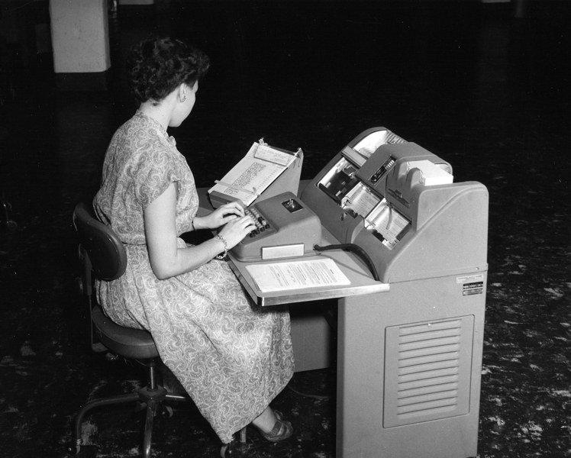
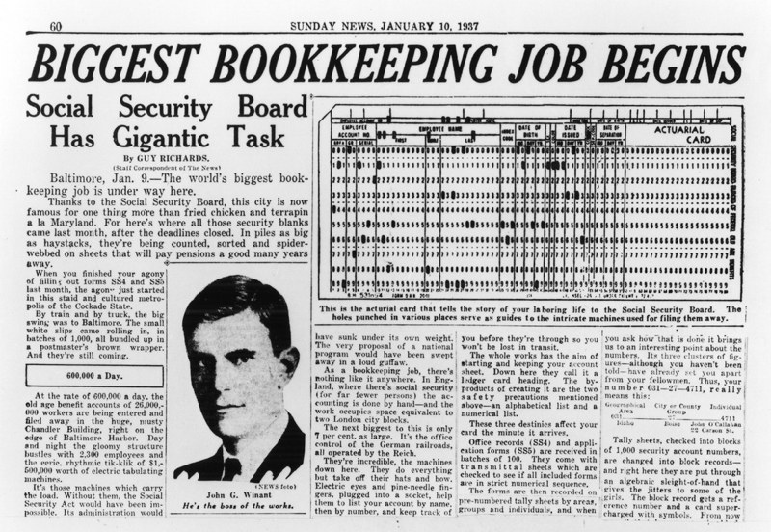
What is big data?
Early “big data” management in the 1930s – source Wired
In 1937 the US government enacted the Social Security Act
Data from 26 million Americans >3 million employers
IBM developed punch card readers specifically for the job

Slide 5

Big data and computing technology
The sheer volume of data produced today requires
A lot of space (virtual and physical) to store data
Large computing power to analyse data
Enhanced security to protect data
One of Google’s data centres – Source Google
Notes:
Google: >2.5 million servers in 2016

Slide 6
Big data in biology
Biology has been affected as well
From “traditional”, hypothesis-driven experimental strategies to large scale exploratory studies

Slide 7
Deduction vs induction
Improve
Known theory
Theory
New hypothesis
Hypothesis
Test with experiment
Find patterns in data
Confirm or discard hyp.
Collect data (a lot of!)

Slide 8
Big data in biology
Biology has been affected as well
From “traditional”, hypothesis-driven experimental strategies to large scale exploratory studies
“Big data” is found in many domains of biomedical research
Genomics
Proteomics
Imaging
…

Slide 9
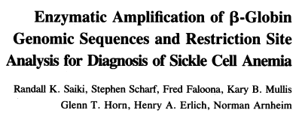
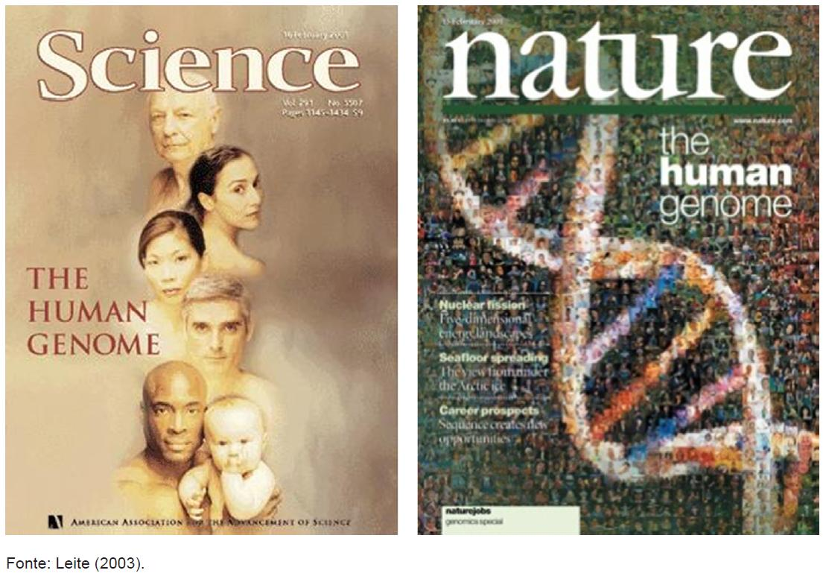
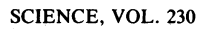
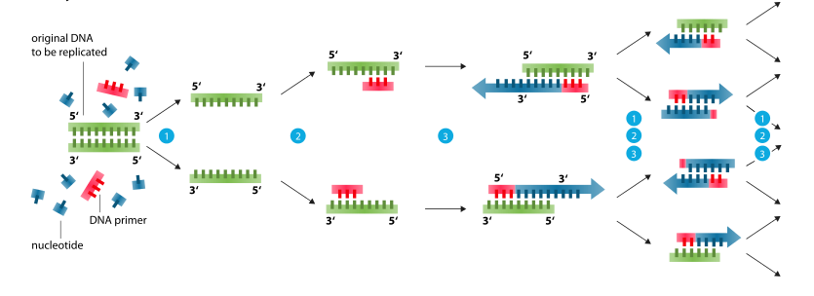
New technologies in genetics
Enormous efforts to sequence the human genome contributed to a big technological push in technologies related to genetics.
Venter, J. C. et al.
Science 291, 304–1351 (2001).
International Human Genome Sequencing Consortium, Nature 409, 860–921 (2001).
PCR – source: Wikipedia
1985 – Kary Mullis develops PCR
2001 – The human genome is sequenced

Slide 10
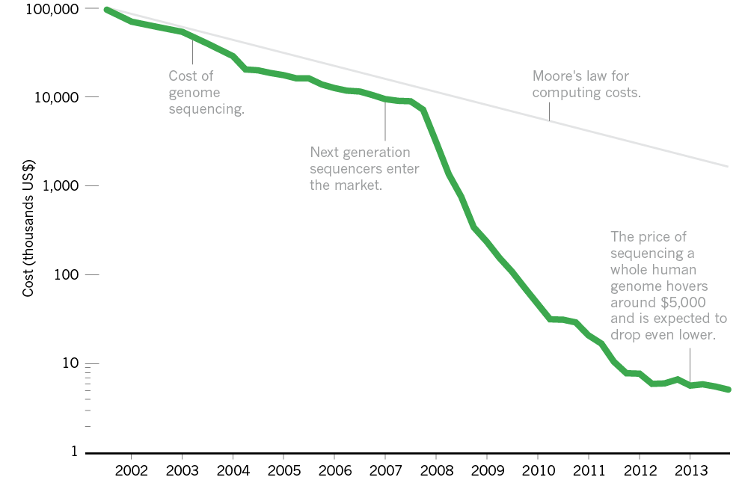
New technologies in genetics
Introduction of next generation sequencing (NGS) made sequencing price drop faster then predicted. Today you can sequence a genome for <$1000.
Nature News, 19/3/2014
Notes:
Human genome project costed ~$100M

Slide 11
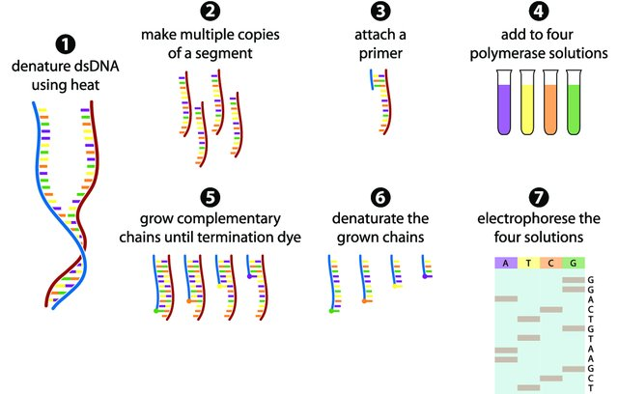
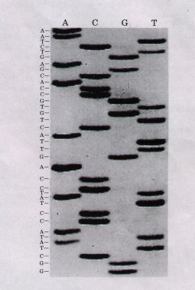
Traditional Sanger sequencing
Based on PCR using “terminator nucleotides” (analogues that can be incorporated in DNA, but cannot have another nucleotide attached)
Gauthier, 2007

Slide 12
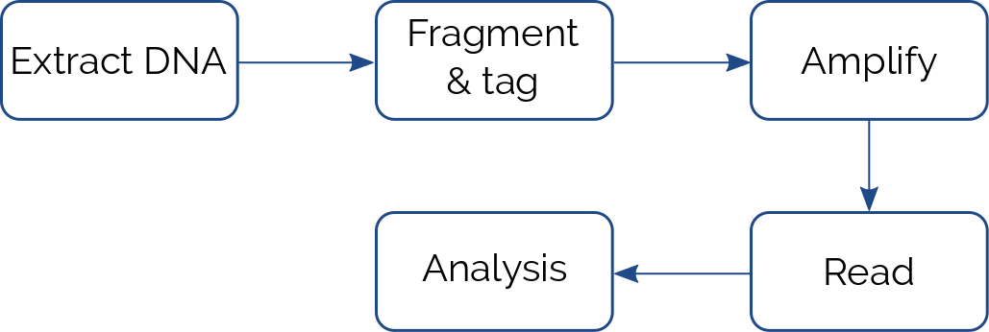
Next generation sequencing
Also called “massive parallel sequencing”. Improved speed and efficiency, reduced costs.
In most cases based on using microfluidics platform
Generally reads small fragments of DNA or RNA (150-300 bp)
Each fragment is called a “read”
State-of-the art machines can sequence up to >30M reads/hour
Notes:
~8000 reads/second

Slide 13
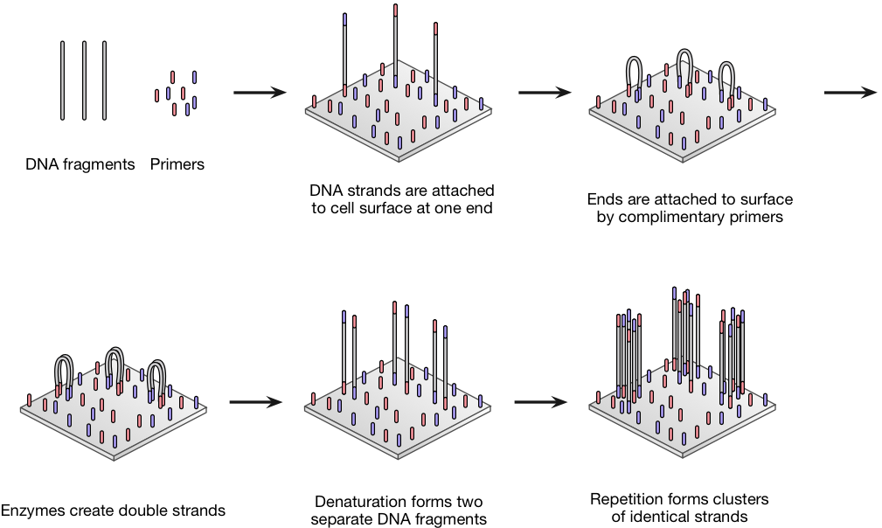
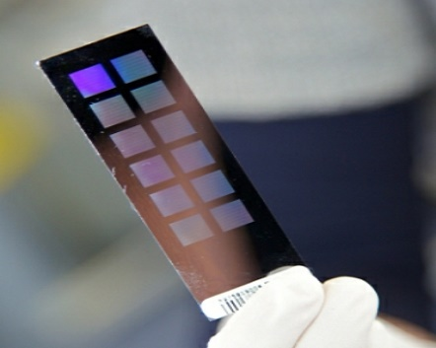
Illumina sequencing
In Illumina sequencing amplification is obtained by “bridge method”
Source: atdbio
Notes:
Adapters can also be used to identify samples

Slide 14
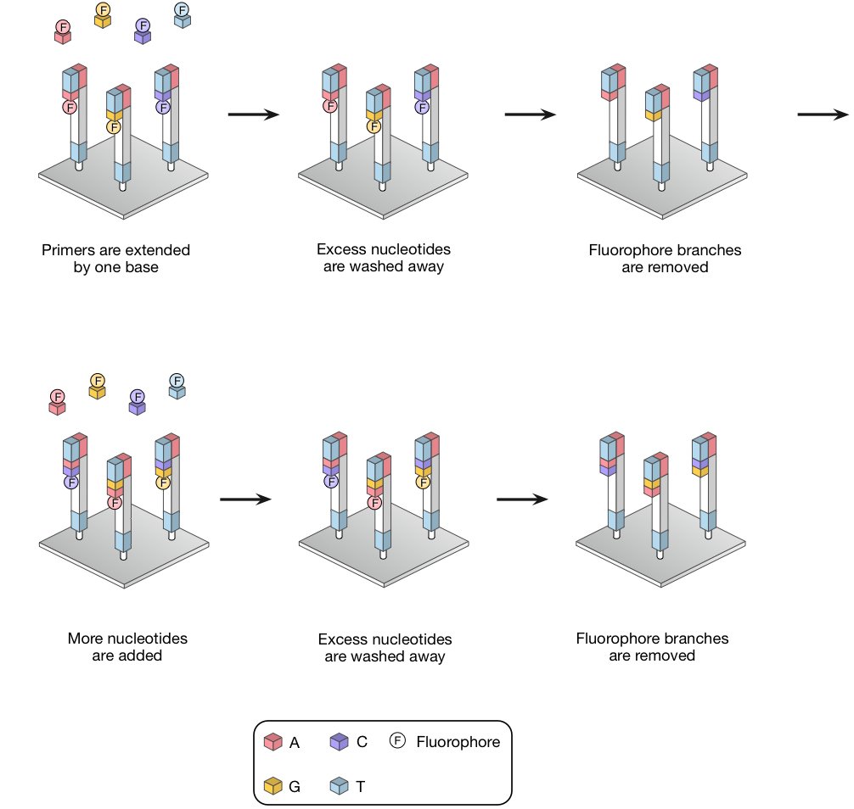
Illumina sequencing
Sequencing by synthesis
Source: atdbio

Slide 15
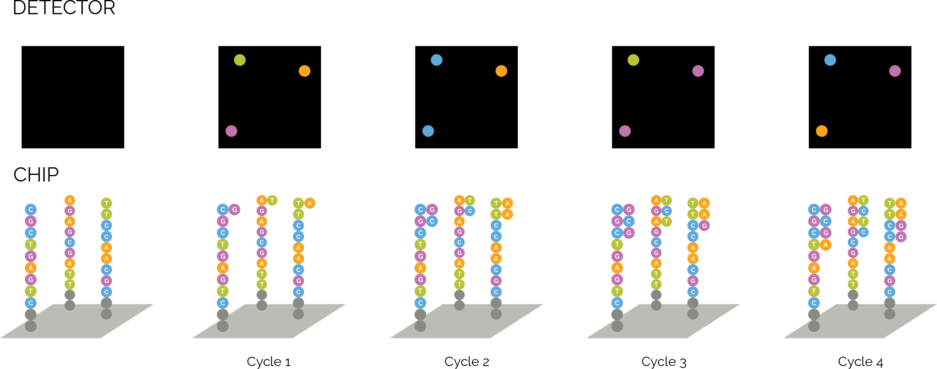
Illumina sequencing
At each step a picture with the spots corresponding to each cluster is taken

Slide 16
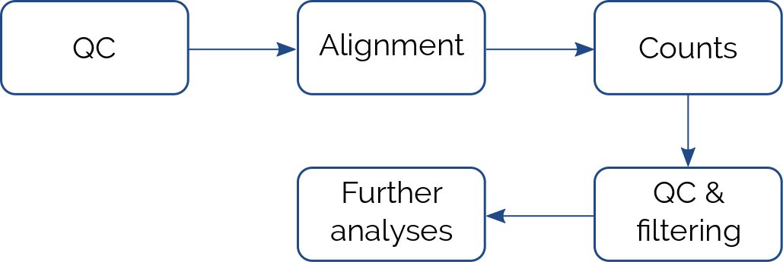
Bioinformatics analysis
The next step is to analyse the data
Data needs to be aligned to the genome and counted
 | Sample 1 | Sample 2 | Sample 3 | Sample 4
Gene 1 | 120 | 0 | 30 | 34
Gene 2 | 85 | 22 | 15 | 0
Gene 3 | 0 | 0 | 2 | 88
Gene 4 | 150 | 230 | 223 | 743
… | … | … | … | …
Gene 20k | 45 | 23 | 55 | 11

Slide 17
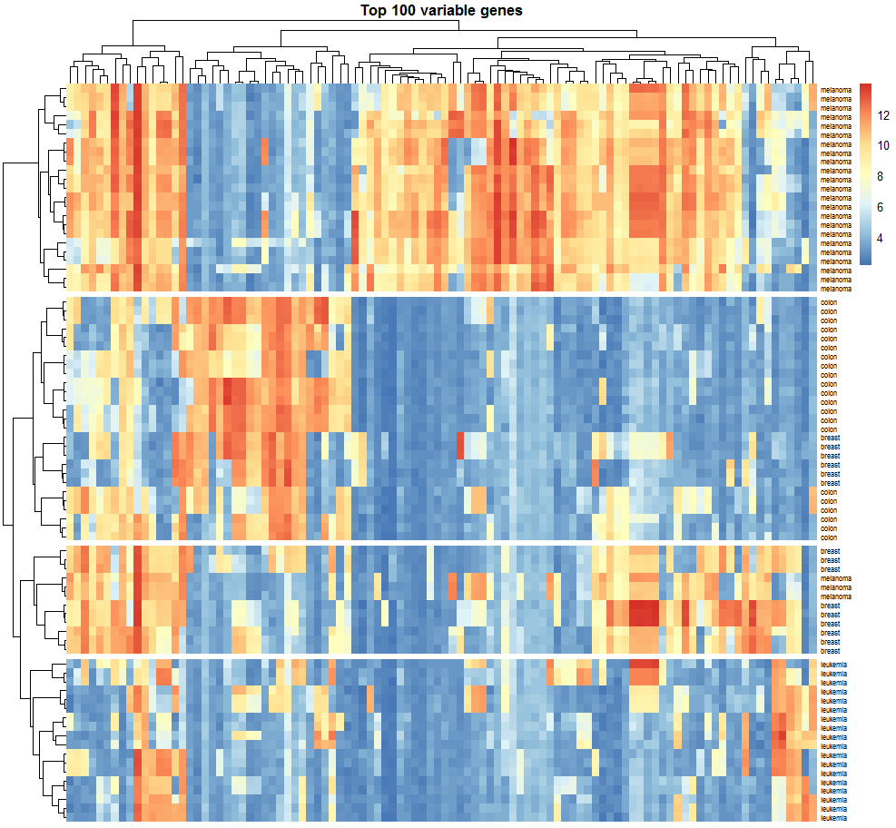
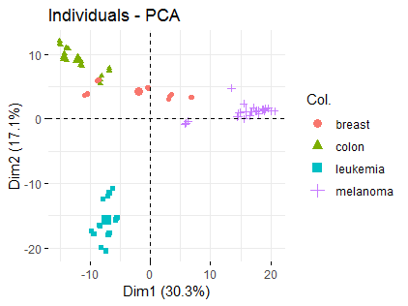
Bioinformatics analysis
Visualization techniques
Heatmaps and clustering, PCA, …

Slide 18
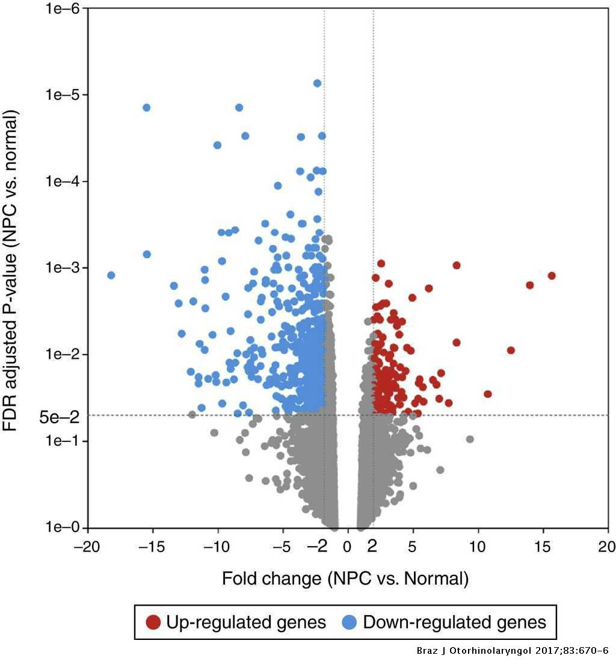
Bioinformatics analysis
Differential expression analysis
Finds genes under-/over-expressed between two samples
Considers fold change and adjusted p-value
Useful to find targets for further analysis
Jiang, 2016

Slide 19
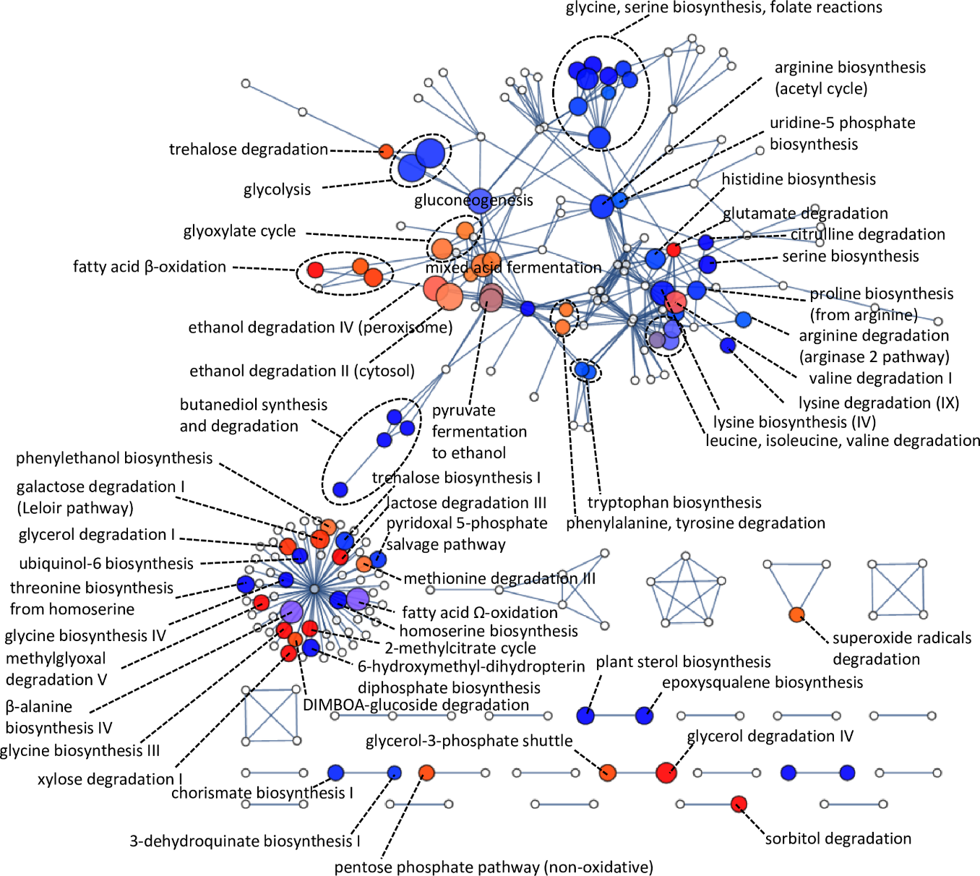
Bioinformatics analysis
Pathway analysis
Finds molecular pathways enriched in the sample
Genes can be mapped to function e.g. through GO annotations
Schabort, 2016

Slide 20
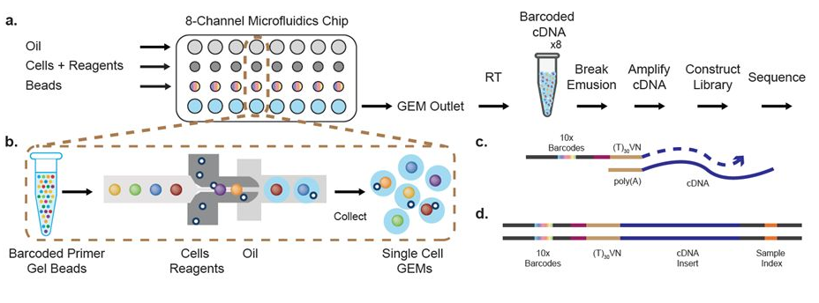
From bulk to single cell sequencing
Recent advances in NGS and microfluidics technology have allowed sequencing of the transcriptome of single cells.
10X sequencing
Generally 10³-10⁵ cells sequenced – 10⁴-10⁵ reads/cell
Other methods (e.g. SmartSeq 2): ~10⁶ reads/cell

Slide 21
What are the issues?
An average file from a RNAseq experiment with ~50M reads is about 20 Gb
This has issues regarding
Computing power
Storage space
Costs
Data management plans are now required in most grants applications
Bioinformatics skills are required (although pre-existing analysis pipelines make things a lot easier than they used to be)

Slide 22
A practical example

Slide 23
Measuring gene expression!
We are interested in measuring gene expression in three sets of patients
Control group (Ctrl) : no liver pathology
Liver fibrosis group (Fibr) : patients with liver fibrosis
Liver cirrhosis group (Cir) : patients with liver cirrhosis
10 patients / group
RNA extracted from liver biopsy, RT-PCR, then expression of target genes assessed by qPCR.

Slide 24
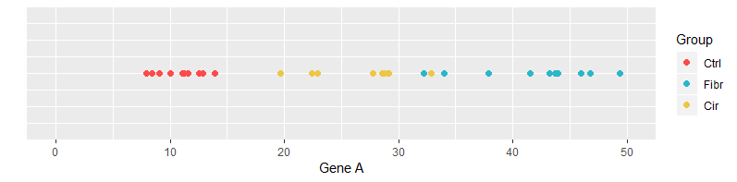
Experiment 1 – 1 gene
Very simple experiment – we only measure gene A
 | Patient 1 | Patient 2 | Patient 3 | Patient 4 | Patient 5 | … | Patient 30
A | 12.5 | 13.9 | 8.4 | 11.3 | 12.9 | … | 22.4
CTRL
Fibr
Cir
Notes:
1D plot, we can clearly see clustering (in this case). This means red vs red dots are more similar than red vs blue

Slide 25
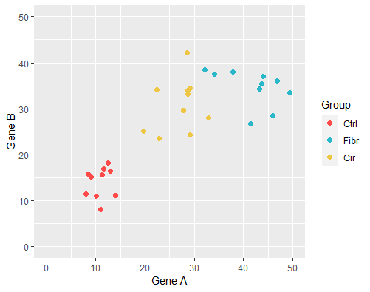
Experiment 2 – 2 genes
Now we measure 2 genes
 | Patient 1 | Patient 2 | Patient 3 | Patient 4 | Patient 5 | … | Patient 30
A | 12.5 | 13.9 | 8.4 | 11.3 | 12.9 | … | 22.4
B | 18.2 | 11.1 | 16.4 | 15.8 | 15.6 | …. | 24.3
CTRL
Fibr
Cir

Slide 26
Experiment 3 – 10 genes
Now we measure 10 genes
 | Patient 1 | Patient 2 | Patient 3 | Patient 4 | Patient 5 | … | Patient 30
A | 12.5 | 13.9 | 8.4 | 11.3 | 12.9 | … | 22.4
B | 18.2 | 11.1 | 16.4 | 15.8 | 15.6 | …. | 24.3
… | …. | …. | …. | …. | …. | …. | ….
J | 32.7 | 28.0 | 30.9 | 42.8 | 31.4 |  | 28.5
Would need a 10D plot!!!!

Slide 27
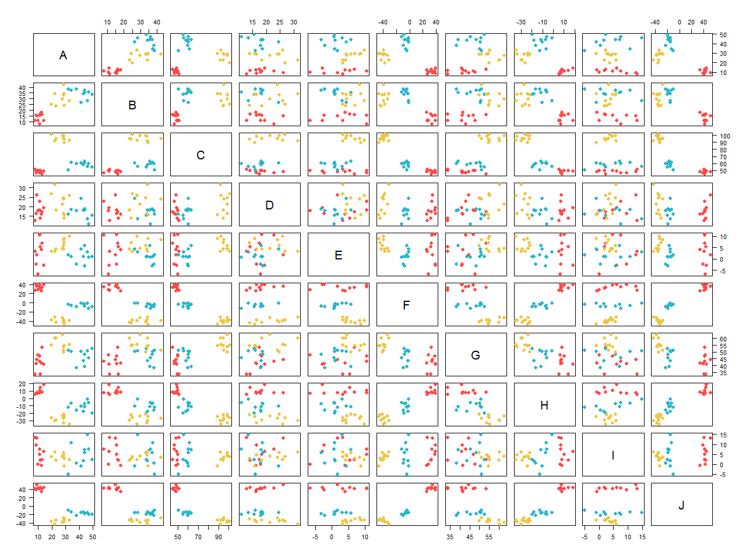
Experiment 3 – 10 genes
Notes:
OK-ish with 10 variables, imagine if we had 1000s!

Slide 28
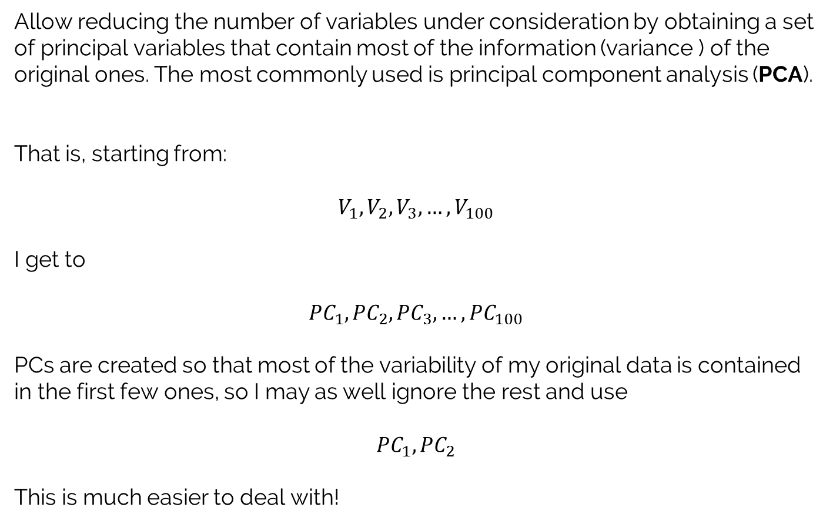
Dimensionality reduction techniques
Allow reducing the number of variables under consideration by obtaining a set of principal variables that contain most of the information (variance ) of the original ones. The most commonly used is principal component analysis (PCA).
That is, starting from:
$$V_{1},V_{2},V_{3}, …,V_{100}$$
I get to
$${PC}_{1},{PC}_{2},{PC}_{3}, …,{PC}_{100}$$
PCs are created so that most of the variability of my original data is contained in the first few ones, so I may as well ignore the rest and use
$${PC}_{1},{PC}_{2}$$
This is much easier to deal with!
PC = principal component;
each PC is a linear combination of the original variables

Slide 29
Experiment 3 – 10 genes
I start from
 | Patient 1 | Patient 2 | Patient 3 | Patient 4 | Patient 5 | … | Patient 30
A | 12.5 | 13.9 | 8.4 | 11.3 | 12.9 | … | 22.4
B | 18.2 | 11.1 | 16.4 | 15.8 | 15.6 | …. | 24.3
… | …. | …. | …. | …. | …. | …. | ….
J | 32.7 | 28.0 | 30.9 | 42.8 | 31.4 |  | 28.5
I get to
 | Patient 1 | Patient 2 | Patient 3 | Patient 4 | Patient 5 | … | Patient 30
PC1 | 0.5 | 0.25 | -0.3 | 1.4 | 2.1 | … | 0.1
PC2 | 0.8 | 0.7 | 0.01 | -0.5 | 1.1 | …. | 2.3

Slide 30
How to do PCA?
Following is a simplified view of how PCA is calculated.
If you really really want to actually learn the maths behind PCA, this is a good start*
A Tutorial on Principal Component Analysis, Jonathon Shlens, 2005
In real life you will ask a computer to calculate it for you!
* Note: lots of matrix calculus involved!

Slide 31
Back to 2 genes!
 | Patient 1 | Patient 2 | Patient 3 | Patient 4 | Patient 5 | … | Patient 30
A | 12.5 | 13.9 | 8.4 | 11.3 | 12.9 | … | 22.4
B | 18.2 | 11.1 | 16.4 | 15.8 | 15.6 | …. | 24.3

Slide 32
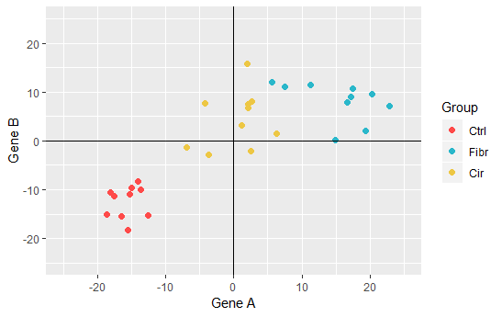
Step 1 – center data
The first thing we want to do is center the data on the origin.
We do this by subtracting the mean of each dimension from each data point

Slide 33
Step 2 – fit a best line
We now want to fit a best fitting line to the data making sure it goes through the origin.

Slide 34
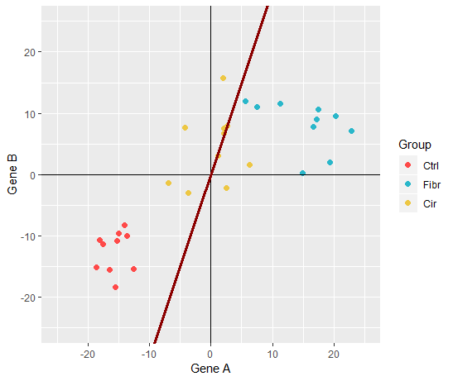
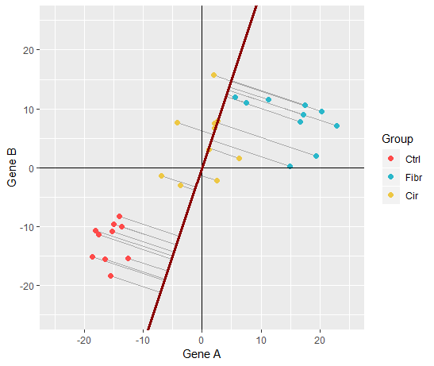
Step 2 – a random line…
PCA tries to minimise the distance from each point to the line
This is equal to maximise the distance between the projection and the origin.
Note that PCA minimises (or maximises) the sum of squares of the distances

Slide 35
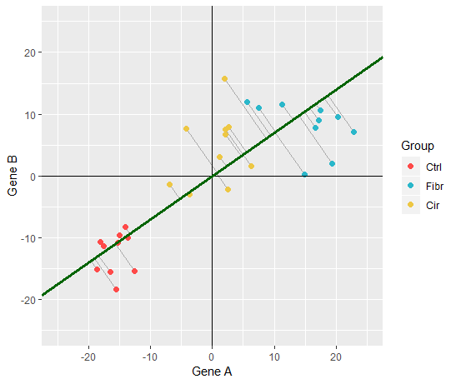
Step 2 – find the best line
Notes:
This was found through some clever matrix algebra. We don’t care about it for the context of this course. R will find it for us.

Slide 36
You got PC1 !
PC1 corresponds (in this example) to the line: $y=0.7 x$
Notes:
This means that for each 10 units on gene A we go up 7 units in gene B
It also means that most of the variance of my dataset is derived by gene A.
So gene A is more important then gene B when we describe our data.

Slide 37
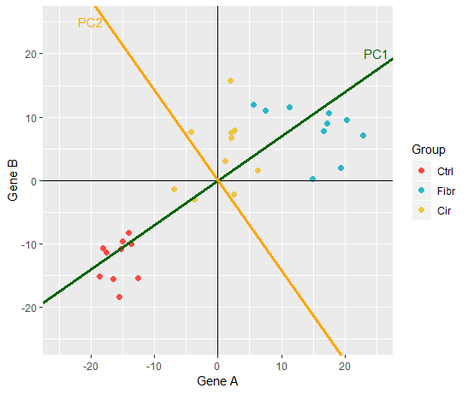
Let’s find PC2!
PC1 is the line perpendicular to PC1, passing through the origin and that minimised the SS distances of the points. In our simple 2D example there is only one line to test… but with more variable there would be more!

Slide 38
And finally, some rotation
We now rotate our coordinate system, until PC1 is horizontal

Slide 39
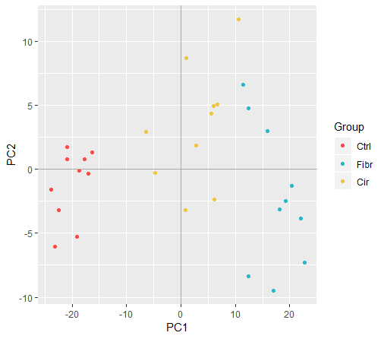
Our PCA is done!

Slide 40
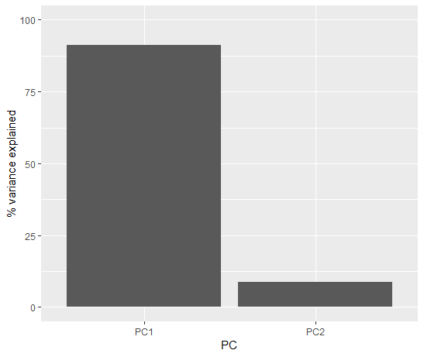
Scree plots
A common way to visualise the contribution of each component is through a scree plot, a bar plot of the variance explained by each PC.
Notes:
PC are ordered in order of importance
PC1 is capturing the majority of change in our data
We can get rid of PC2 (?)

Slide 41
Dimension reduction

Slide 42
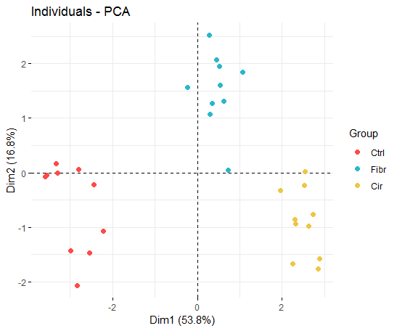
PCA
From 10D… …to 2D!

Slide 43
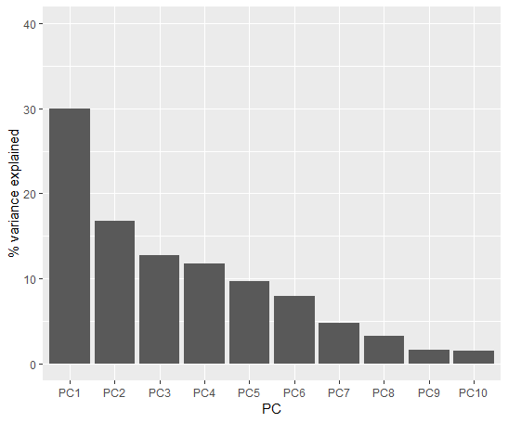
Scree plot

Slide 44
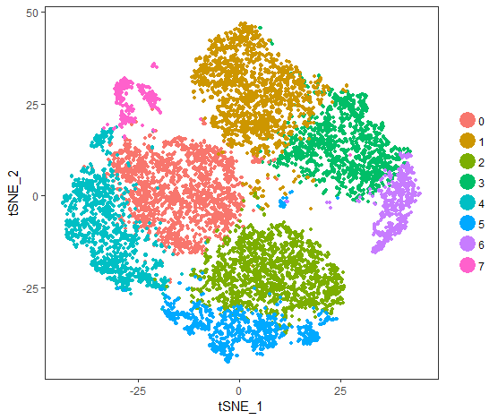
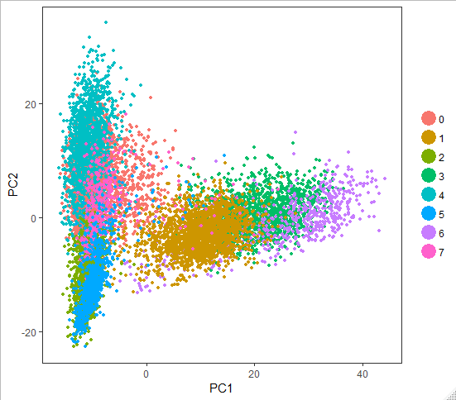
Non-linear dimension reduction
Particularly suited to very high dimensional data, such as that of scRNAseq experiments.
Contrary to PCA they are not linear projections, so it can capture non-linear relationships.
e.g. t-SNE (t-Distributed Stochastic Neighbour Embedding)
Fidanza et al., 2019

Slide 45
Conclusion
New technologies are changing the way we do biology
Large amount of data are now easy and cheap to generate…
…at the cost of not being able to understand what those data mean!
New skills and technologies will be needed ever more in the future!
Data analysis
Machine learning
Data visualization
…

